Slide 1
Object Oriented Concepts
Object-Oriented Programming
3140705
Dr.Chirag Joshi
Department of ICT
chirag.joshi@marwadieducation.edu.in

Slide 2

Looping
What we will learn
Class abstraction and Encapsulation
Thinking in objects and class relationships
Primitive data type and wrapper class types
Big integer and Big decimal class
String class, String Builder and String Buffer class
Inheritance: super class and subclass, using super keyword
Overriding and overloading methods
Polymorphism and dynamic binding
Casting objects and instanceof operator
The ArrayList class and its methods
The protected data and methods

Slide 3
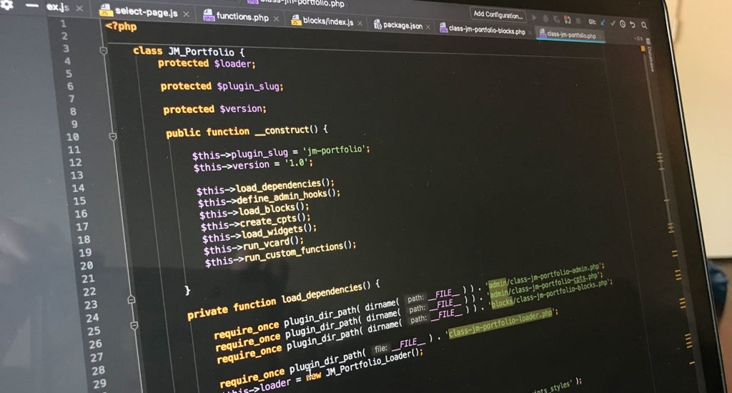
What is OOP?
OOP (Object-Oriented Programming) is a programming paradigm that is completely based on ‘objects’.
Object-Oriented Programs insists to have a lengthy and extensive design phase, which results in improved designs and fewer defects.
Object-oriented programming provides a higher level way for programmers to envision and develop their applications.
In an object-oriented programming language, less emphasis is placed upon the flow of execution control. Instead, the program is viewed as a set of objects interacting with each other in defined ways.
An OOP programmer can bind new software objects to make completely new programs/system.

Slide 4
Philosophy of Object Oriented
Our real world is nothing but classification of objects
E.g. Human, Vehicle, Library, River, Watch, Fan, etc.
Real world is organization of different objects which have their own characteristics, behavior
Characteristic of Human: Gender, Age, Height, Weight, Complexion, etc.
Behavior of Human: Walk, Eat, Work, React, etc.
Characteristic of Library: Books, Members, etc.
Behavior of Library: New Member, Issue Book, Return Book etc.
The OO philosophy suggests that the things manipulated by the program should correspond to things in the real world.
Classification is called a Class in OOP
Real world entity is called an Object in OOP
Characteristic is called Property in OOP
Behavior is called Method in OOP

Slide 5






What is an Object?
Pen
Board
Laptop
Bench
Projector
Bike
Physical objects…

Slide 6
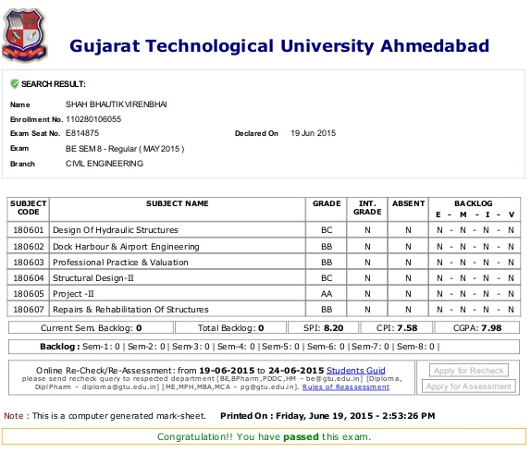

What is an Object? (Cont…)
Result
Bank Account
Logical objects…

Slide 7




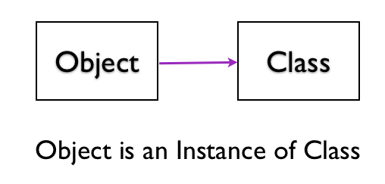
What is an Object?
An Object is a key to understand Object Oriented Technology.
An entity that has state and behavior is known as an object. e.g., Mobile, Car, Door, Laptop etc
Each and every object posses
Identity
State
Behavior
OBJECT

Slide 8

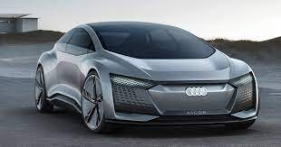




Object: A Real-World Entity
CAR
Class
Object-1 | Object-2 | Object-3 | Object-4 | Object-5

Slide 9

Object: A Real-World Entity
OBJECT: CAR
Events
On_Start
On_Parked
On_Brake
Properties (Describe)
Manufacturer
Model
Color
Year
Price
Methods (Actions)
Start
Drive
Park

Slide 10
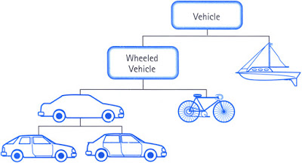
Object: A Real-World Entity

Slide 11
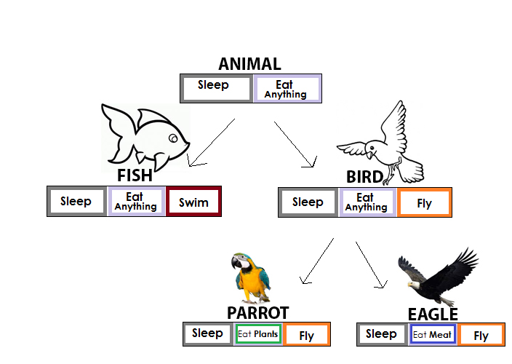
Object: A Real-World Entity

Slide 12
Classes and Objects

Slide 13
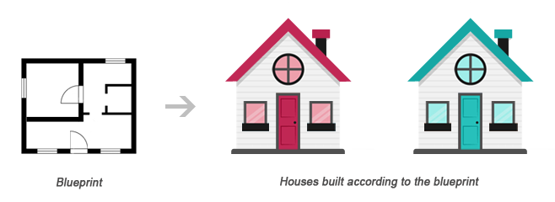
Classes and Objects
Class
Object1
Object2
Class is a blueprint of an object
Object is instance of class
Class describes the object

Slide 14

What is Object-Orientation?

Slide 15
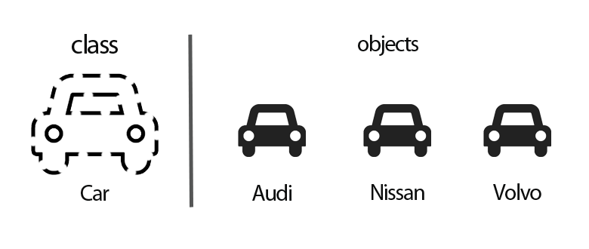
What is Object-Orientation?
Object-oriented modeling and design is a way of thinking about problems using models organized around real-world concepts.
The fundamental construct is object, which combine data structure and behavior.
Object-Oriented Models are useful for
Understanding problems
Communicating with application experts
Modeling enterprises
Preparing documentation
Designing System

Slide 16
Thinking in objects and class relationships

Slide 17
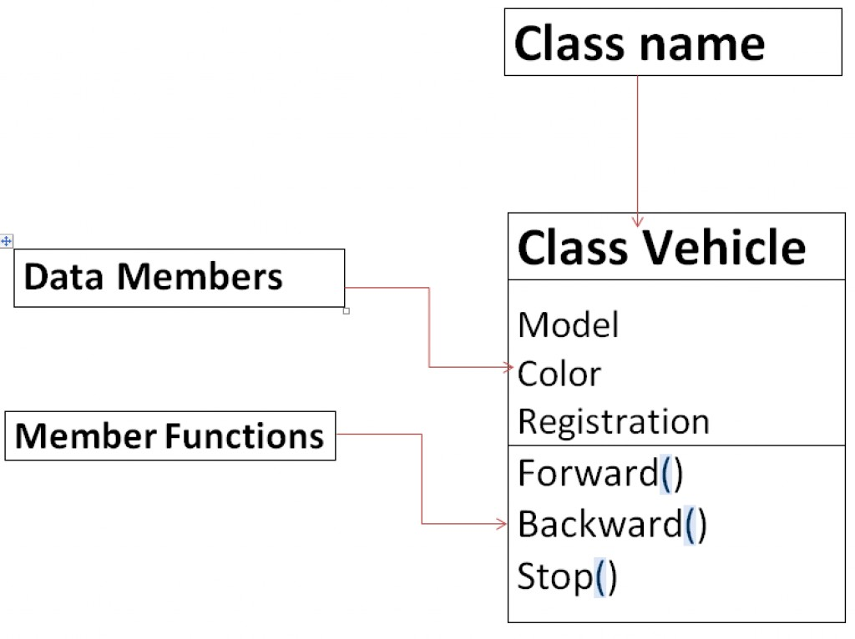
What is Class?
Class can be defined in multiple ways
A class is the building block.
A class is a blueprint for an object.
A class is a user-defined data type.
A class is a collection of objects of a similar kind.
A class is a user-defined data type that combines data and methods.
A class describes both the data and behaviors of objects.
Class contains data members (also known as field or property or data) and member functions (also known as method or action or behavior)
Classes are similar to structures in C.
Class name can be given as per the Identifier Naming Conventions.

Slide 18
Few Real World Classes with properties
Person
University
Book
Student
Name
Gender
Age
Height
Weight
Complexion
Color of Hair
Color of Skin
Profession
Name
Establishment Year
Type
Principal
Courses Offered
Number of Students
Number of Faculties
Land Area
Built Up Area
Title
Author
Publisher
Pages
ISBN
Type
Price
Edition
Volume
Name
BirthDate
BloodGroup
Course
Semester
Mobile
Address
CGPA
ParentName
Cold Drinks
Fan
Social Media
River
Taste
Color
Flavor
Composition
Type (Table, Ceiling, Wall Mounted)
Number of Blades
RPM
Flow of Air
Name
Website
Users
Purpose
Icon
Name
Length
Origin Point
Ending Point
Flow of Water

Slide 19
Classes with behavior / action / methods
Person
University
Book
Student
Name
Gender
Age
Height
Weight
Complexion
Color of Hair
Color of Skin
Profession
Name
Establishment Year
Type
Principal
Courses Offered
Number of Students
Number of Faculties
Land Area
Built Up Area
Title
Author
Publisher
Pages
ISBN
Type
Price
Edition
Volume
Name
BirthDate
BloodGroup
Course
Semester
Mobile
Address
CGPA
ParentName
Person
University
Book
Student
Eat()
Walk()
Run()
Talk()
Work()
...
DisplayUniName()
EnrollStudents()
DisplayPrincipalName()
…
EditBookStatus()
DisplayBookStatus()
DisplayPublisherName()
DisplayAuthorName()
…
RequestAdmission()
PayFees()
ExamRegistration()
ViewResult()
…

Slide 20
Classes with behavior / action / methods
Cold Drinks
Fan
Social Media
River
Name
Taste
Color
Flavor
Composition
Type (Table, Ceiling, Wall Mounted)
Number of Blades
RPM
Flow of Air
Name
Website
Users
Purpose
Icon
Name
Length
Origin Point
Ending Point
Flow of Water
Cold Drinks
Fan
Social Media
River
DisplayType()
DisplayFlavour()
…
ViewType()
DisplayRPM()
…
ViewImage()
SendVideo()
AddFriend()
PostContent()
…
DisplayName()
DisplayOrigin()
DisplayArea()
…

Slide 21
What is Object?
Definition: An Object is an instance of a Class.
An Object is a variable of a specific Class
An Object is a data structure that encapsulates data and functions in a single construct.
Object is a basic run-time entity
Objects are analogous to the real-world entities.

Slide 22
Few of Real World Objects
Person:attribute
Person:method()
Person: object
Name
Gender
Age
Height
Weight
Complexion
Color of Hair
Color of Skin
Profession
Eat()
Walk()
Run()
Talk()
Work()
...
Narendra Modi
Amitabh Bachhan
Sachin Tendulkar
Arijit Singh
Brad Pitt
R.G. Dhamsania

Slide 23
Few of Real World Objects
University: attribute
University: method()
University: object
Name
Establishment Year
Type
Principal
Courses Offered
Number of Students
Number of Faculties
Land Area
Built Up Area
EnrollStudents()
GenerateResult()
GenerateFeeReceipt()
…
Nirma University
Darshan University
Gujarat Technological University
Saurashtra University
Veer Narmad University

Slide 24
Few of Real World Objects
Person: object
University: object
Book: object
Student: object
Narendra Modi
Amitabh Bachhan
Sachin Tendulkar
Arijit Singh
Brad Pitt
R.G. Dhamsania
Nirma University
Darshan University
Gujarat Technological University
Saurashtra University
Veer Narmad University
Programming in C
The Secret
Two States
Bhagwad Gita
Ramayan
The Holy Bible
Jack
Twinkle
John
Sita
Karan
Cold Drinks: object
Fan: object
Social Media: object
River: object
Coca Cola
Pepsi
Fanta
Spice
Sosyo
Orient PSPO
Havells Galaxy
Bajaj Crest Neo
Usha Ex9
Crompton
Twitter
Whatsapp
Instagram
Facebook
Orkut
Ganga
Narmada
Aji
Nile
Thames

Slide 25

Object-Orientated Languages

Slide 26















Object-Orientated Languages

Slide 27
Object-Oriented vs. Procedure-Oriented

Slide 28
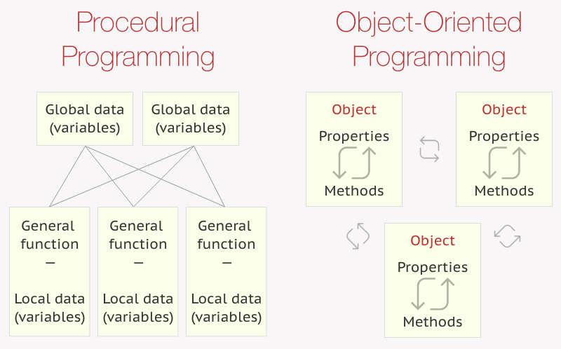

Object-Oriented vs Procedure-Oriented Language

Slide 29
Procedural Programming v/s Object Oriented Programming
Procedural Programming | Object Oriented Programming
Program is divided into functions | Program is divided into classes & objects
The emphasis is on doing things | The emphasis is on data
Poor modeling to real world problems | Strong modeling to real world problems
Difficult to maintain large projects | Easy to maintain large projects
Poor data security | Strong data security
Code can’t be reused in another project | Code can be reused across the projects
Not extensible | Extensible
Productivity is low | Productivity is high
Don’t provide support for new data types | Provides support to new data types
Don’t provide automatic memory management | Provides automatic memory management
e.g. Pascal, C, Basic, Fortran | e.g. C++, C#, Java

Slide 30
Principles of OOP

Slide 31
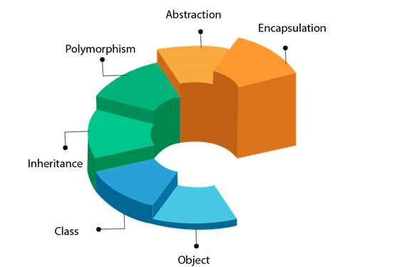
Principles of OOP

Slide 32
Pillars of OOP
Inheritance
Polymorphism
Encapsulation
Abstraction

Slide 33

Inheritance

Slide 34
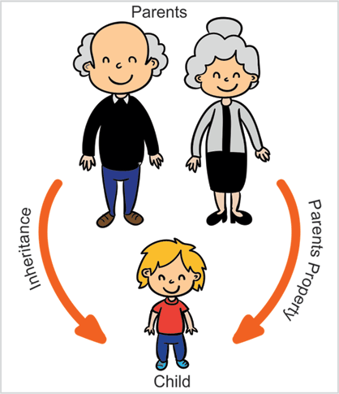
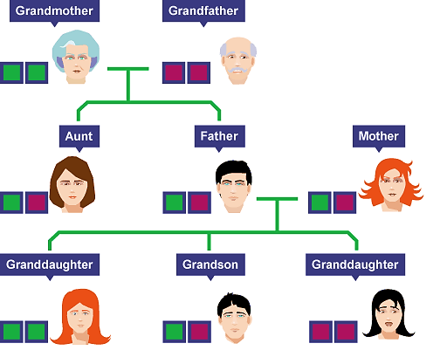

Inheritance

Slide 35
Inheritance
class Doctor
class Footballer
class Businessman
Attributes:
Age, Height, Weight
Methods:
Talk()
Walk()
Eat()
Diagnose()
Attributes:
Age, Height, Weight
Methods:
Talk()
Walk()
Eat()
Playfootball()
Attributes:
Age, Height, Weight
Methods:
Talk()
Walk()
Eat()
Runbusiness()
All of the classes have common attributes (Age, Height, Weight) and methods (Walk, Talk, Eat).
However, they have some special skills like Diagnose, Playfootball and Runbusiness.
In each of the classes, you would be copying the same code for Walk, Talk and Eat for each character.

Slide 36
Inheritance
The mechanism of a class to derive properties and characteristics from another class is called Inheritance.
It is the most important feature of Object Oriented Programming.
Inheritance is the process, by which class can acquire(reuse) the properties and methods of another class.
Base Class: The class whose properties are inherited by sub class is called Base Class/Super class/Parent class.
Derived Class: The class that inherits properties from another class is called Sub class/Derived Class/Child class.
Inheritance is implemented using super class and sub class relationship in object-oriented languages.
Base Class
Derived Class

Slide 37
Inheritance
class Person is called Base class
class Person
Attributes:
Age, Height, Weight
Methods:
Talk() , Walk(), Eat()
class Doctor
class Footballer
class Businessman
Methods:
Diagnose()
Methods:
Playfootball()
Methods:
Runbusiness()
These classes are called Derived class

Slide 38
Inheritance
class Vehicle
Attributes:
Engine_no, color
Methods:
apply_breaks()
class Car
class Bus
class Truck
Attributes:
Private_vehicle
Attributes:
Public_vehicle
Attributes:
Goods_vehicle

Slide 39
Inheritance: Advantages
Promotes reusability
When an existing code is reused, it leads to less development and maintenance costs.
It is used to generate more dominant objects.
Avoids duplicity and data redundancy.
Inheritance makes the sub classes follow a standard interface.
Base Class
Derived Class

Slide 40
Implementing Inheritance
Subclass-Superclass Relationship

Slide 41
Introduction
Inheritance is the process, by which a class can acquire(reuse) the properties and methods of another class.
The mechanism of deriving a new class from an old class is called inheritance.
The new class is called derived class and old class is called base class.
The derived class may have all the features of the base class and the programmer can add new features to the derived class.
Inheritance is also known as “IS-A relationship” between parent and child classes.
For Example :
Car IS A Vehicle
Bike IS A Vehicle
EngineeringCollege IS A College
MedicalCollege IS A College
MCACollege IS A College

Slide 42
Inheritance Example
class Vehicle
Attributes:
Engineno, color
Methods:
applybreaks()
class Car
class Bus
class Truck
Attributes:
privatevehicle
Attributes:
publicvehicle
Attributes:
goodsvehicle

Slide 43
How to implement Inheritance in java
To inherit a class, you simply incorporate the definition of one class into another by using the extends keyword.
Syntax:
class subclass-name extends superclass-name {
// body of class…
}

Slide 44
Implementing Inheritance in java
class A
{
//SuperClass or ParentClass or BaseClass
}
Class A
Base Class
the keyword “extends” is used to create a subclass of A
class B extends A
{
//SubClass or ChildClass or DerivedClass
}
Class B
Derived Class

Slide 45
Implementing Inheritance in java
class Person
{
String name;
long contact;
}
class Employee extends Person
{
int empID;
String designation;
}
Class Customer extends Person
{
int customerID;
int invoiceNo;
}
Person
name:String Contact:long
Employee
empID:int Designation:String
Customer
customerID:int InvoiceNo:int

Slide 46
Implementing Inheritance in java
class Person
{
String name;
long contact;
public void dispContact()
{ System.out.println(“num=”+contact);
}
}
class Employee extends Person
{
int empID;
String designation;
}
Class Customer extends Person
{
int customerID;
int invoiceNo;
}
Person
name:String Contact:long
dispContact():void
Employee
empID:int Designation:String
Customer
customerID:int InvoiceNo:int

Slide 47
Property of Inheritance

Slide 48
Property of Inheritance
A class member that has been declared as private will remain private to its class. It is not
accessible by any code outside its class, including subclasses.
Base class A can’t access attributes and methods of Derived Class B
Class A
Base Class
Derived Class B can’t access private members of Base class A
Class B
Derived Class
Derived Class B can access attributes and methods of Base class A

Slide 49
Inheritance by Example

Slide 50
Example1: InheritanceDemo1
A
#i:int ~j:int
showij():void
B
~k:int
showk():void add():void

Slide 51
Example1: InheritanceDemo.java
class A{
protected int i;
int j;
void showij(){
System.out.println("i="+i+" j="+j);
}
}
class B extends A{ //inheritance
int k;
void showk(){
System.out.println("k="+k);
}
void add(){ System.out.println("i+j+k="+(i+j+k));
}
}
class InheritanceDemo{
public static void main(String[] args)
{
A superObjA= new A();
superObjA.i=10;
superObjA.j=20;
B subObjB= new B();
subObjB.k=30;
superObjA.showij();
subObjB.showk();
subObjB.add();
}
}
Output
i=10 j=20
k=30
i+j+k=30

Slide 52
Types of Inheritance in Java
1. Single Inheritance
2. Hierarchical Inheritance
3. Multilevel Inheritance
A
A
A
B
B
C
B
C
4. Multiple Inheritance
5. Hybrid Inheritance
A
B
A
Note: Multiple and Hybrid Inheritance is not supported in Java with the Class Inheritance, we can still use those Inheritance with Interface which we will learn in later part of the Unit
B
C
C
D

Slide 53
Single Inheritance
A
B

Slide 54
Single Inheritance: InheritanceDemo.java
class A{
protected int i;
int j;
void showij(){
System.out.println("i="+i+" j="+j);
}
}
class B extends A{ //inheritance
int k;
void showk(){
System.out.println("k="+k);
}
void add(){ System.out.println("i+j+k="+(i+j+k));
}
}
class InheritanceDemo{
public static void main(String[] args)
{
A superObjA= new A();
superObjA.i=10;
superObjA.j=20;
B subObjB= new B();
subObjB.i=100
subObjB.j=100;
subObjB.k=30;
superObjA.showij();
subObjB.showk();
subObjB.add();
}
}
A
B
Output
i=10 j=20
k=30
i+j+k=230

Slide 55
Hierarchical Inheritance
A
B
C

Slide 56
class A{
protected int i;
int j;
void showij(){
System.out.println("inside class A:i="+i+" j="+j);
}
}
class B extends A{
int k;
void showk(){ System.out.println("inside class B:k="+k);
}
void add_ijk(){ System.out.println(i+"+"+j+"+"+ k+"="+(i+j+k));
}}
class C extends A{
int m;
void showm(){
System.out.println("inside class C:k="+m);
}
void add_ijm(){
System.out.println(i+"+"+j+ "+"+m+"="+(i+j+m));
}
}
A
B
C
InheritanceLevel.java

Slide 57
class InheritanceLevel{
public static void main(String[] args) {
A superObjA= new A();
superObjA.i=10;
superObjA.j=20;
superObjA.showij();
B subObjB= new B();
subObjB.i=100;
subObjB.j=200;
subObjB.k=300;
subObjB.showk();
subObjB.add_ijk();
C subObjC= new C();
subObjC.i=1000;
subObjC.j=2000;;
subObjC.m=3000;
subObjC.showm();
subObjC.add_ijm();
}
}
InheritanceLevel.java
A
B
C
Output
inside class A:i=10 j=20
inside class B:k=300
100+200+300=600
inside class C:k=3000
1000+2000+3000=6000

Slide 58
Multilevel Inheritance
A
B
C

Slide 59
class A{
protected int i;
int j;
void showij(){
System.out.println("inside class A:i="+i+" j="+j);
}
}
class B extends A{
int k;
void showk(){ System.out.println("inside class B:k="+k);
}
void add_ijk(){ System.out.println(i+"+"+j+"+"+ k+"="+(i+j+k));
}}
class C extends B{
int m;
void showm(){
System.out.println("inside class C:k="+m);
}
void add_ijkm(){
System.out.println(i+"+"+j+ "+"+k+"+"+m+"="+(i+j+k+m));
}
}
A
B
C
InheritanceMultilevel.java

Slide 60
class InheritanceMultilevel{
public static void main(String[] args) {
A superObjA= new A();
superObjA.i=10;
superObjA.j=20;
superObjA.showij();
B subObjB= new B();
subObjB.i=100;
subObjB.j=200;
subObjB.k=300;
subObjB.showk();
subObjB.add_ijk();
C subObjC= new C();
subObjC.i=1000;
subObjC.j=2000;
subObjC.k=3000;
subObjC.m=4000;
subObjC.showm();
subObjC.add_ijkm();
}
}
InheritanceMultilevel.java
A
B
C
Output
inside class A:i=10 j=20
inside class B:k=300
100+200+300=600
inside class C:k=4000
1000+2000+3000+4000=10000

Slide 61
Derived Class with Constructor

Slide 62
Derived Class with Constructor
Cube
# height: double # width: double # depth: double
Cube() volume(): double
CubeInherit
cw1:CubeWeight cw2:CubeWeight
main(): void
CubeWeight
# weigth: double
CubeWeight(double, double, double, double):double

Slide 63
class Cube{
protected double height,width,depth;
Cube(){
System.out.println("inside
default Constructor:CUBE");
}
double volume(){
return height*width*depth;
}
}
class CubeInherit{
public static void main(String[] args) {
CubeWeight cw1= new
CubeWeight(10,10,10,20.5);
CubeWeight cw2= new
CubeWeight(100,100,100,200.5);
System.out.println("cw1.volume()=" +cw1.volume());
System.out.println("cw2.volume()=" +cw2.volume());
}}
class CubeWeight extends Cube{
double weigth;
CubeWeight(double h,double w,double d, double m)
{
System.out.println("inside Constructor:
CUBEWEIGTH");
height=h;
width=w;
depth=d;
weigth=m;
}}
CubeInherit.java
Output
inside default Constructor:CUBE
inside Constructor:CUBEWEIGTH
inside default Constructor:CUBE
inside Constructor:CUBEWEIGTH
cw1.volume()=1000.0
cw2.volume()=1000000.0

Slide 64
Super Keyword

Slide 65
Super Keyword
Whenever a subclass needs to refer to its immediate superclass, it can do so by use of the keyword super. Super has two general forms:
Calls the superclass constructor.
Used to access a members(i.e. instance variable or method) of the superclass.

Slide 66
Using super to Call Superclass Constructors
Call to super must be first statement in constructor
Cube
# height: double # width: double # depth: double
volume(): double
CubeInherit
cw1:CubeWeight cw2:CubeWeight
main(): void
Using “super”
Cube(double, double, double)
CubeWeight
# weigth: double
CubeWeight(double, double, double, double)

Slide 67
class Cube{
protected double height,width,depth;
Cube(double h,double w,double d){
System.out.println("Constructor:
CUBE");
height=h;
width=w;
depth=d;
}
double volume(){
return height*width*depth;
}
}
class CubeInheritSuper{
public static void main(String[] args) {
CubeWeight cw1= new CubeWeight(10,10,10,20.5);
CubeWeight cw2= new CubeWeight(100,100,100,200.5);
System.out.println("cw1.volume()="+cw1.volume());
System.out.println("cw1.weigth="+cw1.weigth);
System.out.println("cw2.volume()="+cw2.volume());
System.out.println("cw2.weigth="+cw2.weigth);
}
}
CubeInheritSuper.java
Output
class CubeWeight extends Cube{
double weigth;
CubeWeight(double h,double w,double d, double m){
super(h,w,d); //call superclassConstructor
System.out.println("Constructor:CUBEWEIGTH");
weigth=m;
}
}
Constructor:CUBE
Constructor:CUBEWEIGTH
Constructor:CUBE
Constructor:CUBEWEIGTH
cw1.volume()=1000.0
cw1.weigth=20.5
cw2.volume()=1000000.0
cw2.weigth=200.5
Using super to Call Superclass Constructors

Slide 68
Using super to access members
The second form of super acts somewhat like this, except that it always refers to the superclass of the subclass in which it is used.
Syntax:
This second form of super is most applicable to situations in which member names of a subclass hide members by the same name in the superclass.
member can be either a method or an instance variable.
super.member

Slide 69
Using super to access members: SuperMemberDemo.java
class A{
}
class B extends A{
int i,k;
B(int a,int b){
this.i=b;
}
void show(){
System.out.println("super.i="+super.i);
System.out.println("this.i="+this.i);
}
}
class SuperMemberDemo{
public static void main(String[] args)
{
B b= new B(12,56);
b.show();
}
}
int i;
super.i=a;
Output
super.i=12
this.i=56

Slide 70
Using super to access members: SuperMemberDemo.java
class A{
int i=33;
void show(){
System.out.println("inside A:i="+i);
}
}
class B extends A{
int i,k;
B(int a,int b){
super.show();
super.i=a;
this.i=b;
}
void show(){
System.out.println("super.i="+super.i);
System.out.println("this.i="+this.i);
}
}
class SuperMemberDemo{
public static void main(String[] args)
{
B b= new B(12,56);
b.show();
}
}
Output
inside A:i=33
super.i=12
B.i=56

Slide 71
Points to remember for super
When a subclass calls super( ), it is calling the constructor of its immediate superclass.
This is true even in a multileveled hierarchy.
super( ) must always be the first statement executed inside a subclass constructor.
If a constructor does not explicitly call a superclass constructor, the Java compiler automatically inserts a call to the no-argument constructor of the superclass.
The most common application of super keyword is to eliminate the ambiguity between members of superclass and sub class.

Slide 72
Why Inheritance
Reusability of code
To implement polymorphism at run time (method overriding).
Class A
Base Class
Class B
Derived Class

Slide 73
Access Control

Slide 74
Access Control
Access Modifier | Description
Private(-) | The access level of a private modifier is only within the class. It cannot be accessed from outside the class.
Default(~) | The access level of a default modifier is only within the package. It cannot be accessed from outside the package. If you do not specify any access level, it will be the default.
Protected(#) | The access level of a protected modifier is within the package and outside the package through child class. If you do not make the child class, it cannot be accessed from outside the package.
Public(+) | The access level of a public modifier is everywhere. It can be accessed from within the class, outside the class, within the package and outside the package.

Slide 75
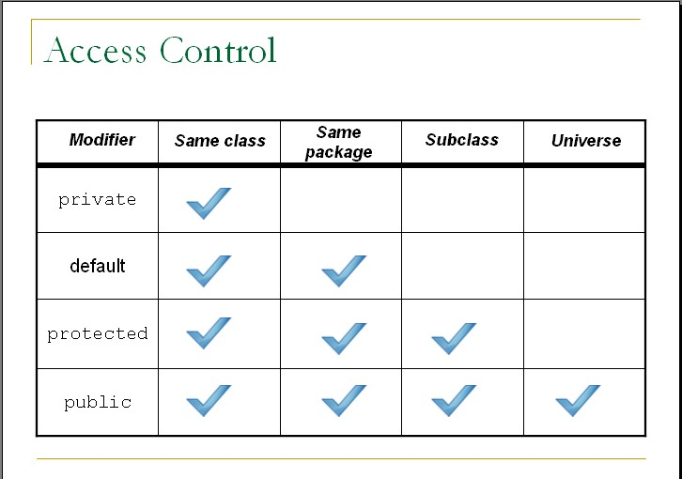
Access Control
Access Modifier | Same Class | Same Package | Sub Class | Universal
Private
Default
Protected
Public

Slide 76
Exercise
Why multiple and Hybrid inheritance is not supported in java.
Implement inheritance in java using following diagram.
Shape
#String name + String color
Shape()
Circle
~ radius: double ~PI: double
calCircleArea(): double
Rectangle
~height: double ~width: double
calRectArea(): double
Triangle
~length: double ~width: double
calTriArea(): double

Slide 77
Interview Questions
Which class in Java is superclass of every other class?
Can a class extend itself?
Can we assign superclass to subclass?
Can a class extend more than one class?

Slide 78
Polymorphism

Slide 79

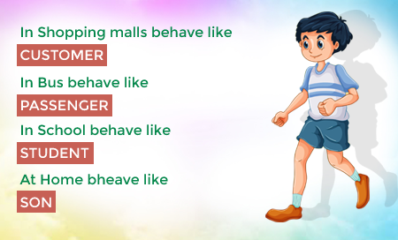



Polymorphism
Polymorphism: It is a Greek term means, “One name many Forms”
Polymorphism
Poly:
Many
Morphism:
Types
Most important concept of object oriented programming
In OOP, Polymorphism is the ability of an object to take on many forms.

Slide 80
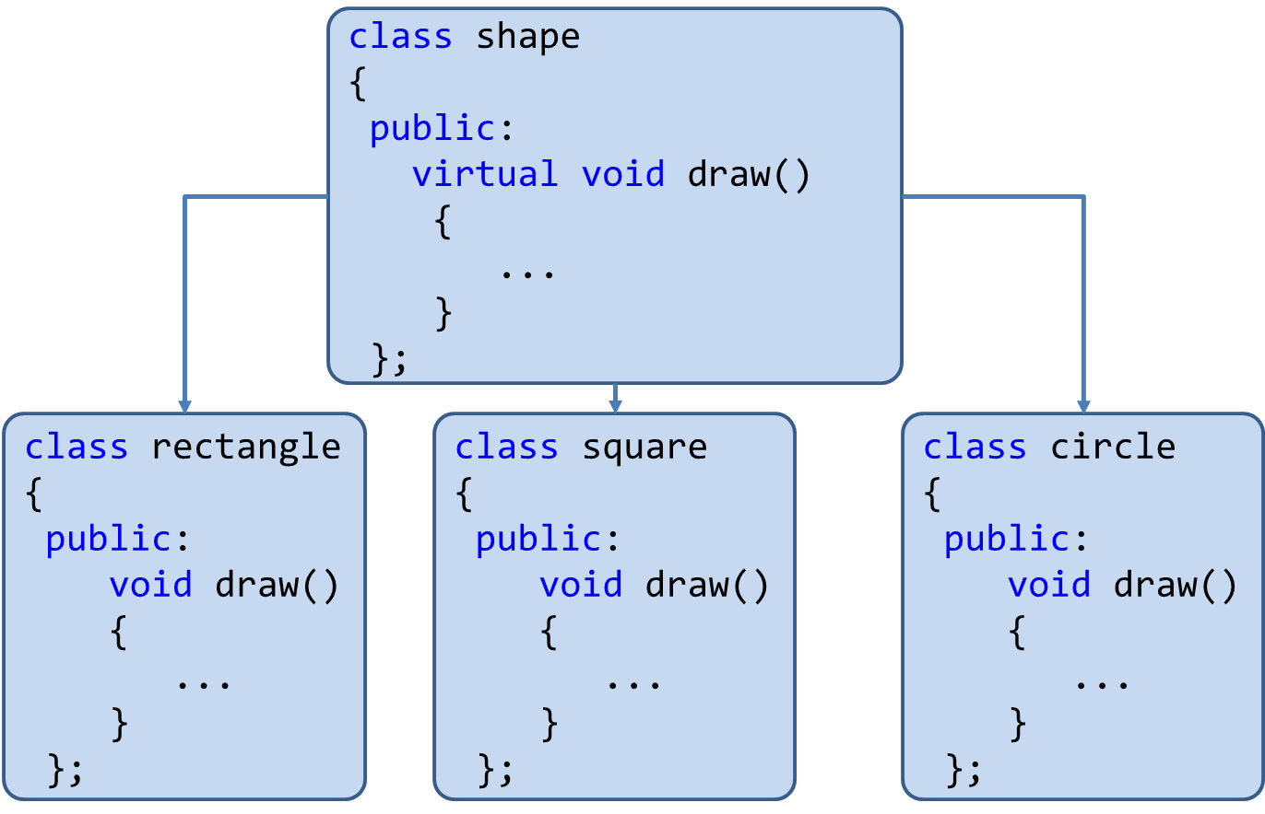
Polymorphism
Polymorphism is the method in an object-oriented programming language that does different things depending on the class of the object which calls it.
Polymorphism can be implemented using the concept of overloading and overriding.

Slide 81
Polymorphism: Advantages
Single variable can be used to store multiple data types.
Easy to debug the codes.
It allows to perform a single act in different ways.
Polymorphism allows the object to decide which form of the function to implement at compile-time (overloading) as well as run-time (overriding).
Reduces coupling, increases reusability and makes code easier to read.

Slide 82
Implementing Polymorphism
Polymorphism
Using
Method Overloading
Using
Method Overriding

Slide 83
Implementing Polymorphism
Overloading & Overrding

Slide 84
Implementing Polymorphism
Polymorphism
Using
Method Overloading
Using
Method Overriding

Slide 85
Method Overloading

Slide 86
Method Overloading: Compile-time Polymorphism
Definition: When two or more methods are implemented that share same name but different parameter(s), the methods are said to be overloaded, and the process is referred to as method overloading
Method overloading is one of the ways that Java implements polymorphism.
When an overloaded method is invoked, Java uses the type and/or number of arguments as its guide to determine which version of the overloaded method to actually call.
E.g. public void draw()
public void draw(int height, int width)
public void draw(int radius)
Thus, overloaded methods must differ in the type and/or number of their parameters.
While in overloaded methods with different return types and same name & parameter are not allowed ,as the return type alone is insufficient for the compiler to distinguish two versions of a method.

Slide 87
Method Overloading: Compile-time Polymorphism
class OverloadDemo{
public static void main(String[] args){
Addition a1= new Addition();
//call all versions of add()
a1.add(20);
a1.add(30,50);
a1.add(10,30,60);
}
}
class Addition{
int i,j,k;
void add(int a){
i=a;
System.out.println("add i="+i);
}
void add(int a,int b){\\overloaded add()
i=a;
j=b;
System.out.println("add i+j="+(i+j));
}
void add(int a,int b,int c){\\overloaded add()
i=a;
j=b;
k=c;
System.out.println("add i+j+k="+(i+j+k));
}
}
Output
add i=20
add i+j=80
add i+j+k=100

Slide 88
Method Overriding

Slide 89
Method Overriding: Run-time Polymorphism
In a class hierarchy, when a method in a subclass has the same name and type signature as a method in its superclass, then the method in the subclass is said to override the method in the superclass.
Definition: If subclass (child class) has the same method as declared in the parent class, it is known as method overriding in Java.

Slide 90
Method Overriding: OverrideDemo.java
class OverrideDemo{
public static void main(String[] args) {
Circle c= new Circle();
c.draw(); //child class meth()
Square sq= new Square();
sq.draw();//child class meth()
Shape sh= new Shape();
sh.draw();//parentClass meth()
}
}
class Shape{
void draw(){
System.out.println("Draw Shape");
}
}
class Circle extends Shape{
void draw(){
System.out.println("Draw Circle");
}
}
class Square extends Shape{
void draw(){
System.out.println("Draw Square");
}
}
When an overridden method is called from within a subclass, it will always refer to the version of that method defined by the subclass. The version of the method defined by the superclass will be hidden.
Output
Draw Circle
Draw Square
Draw Shape

Slide 91
Method Overriding: OverrideDemo.java
class OverrideDemo{
public static void main(String[] args) {
Circle c= new Circle();
c.draw();
Square sq= new Square();
sq.draw();
}
}
class Shape{
void draw(){
System.out.println("Draw Shape");
}
}
class Circle extends Shape{
void draw(){
System.out.println("Draw Circle");
}
}
class Square extends Shape{
void draw(){
System.out.println("Draw Square");
}
}
super.draw();
Here, super.draw( ) calls the superclass version of draw( ).
Output
Draw Shape
Draw Circle
Draw Square
Overridden methods in Java are similar to virtual functions in C++ and C#.

Slide 92
Why Overriding?
Method overriding is used to provide the specific implementation of a method which is already provided by its superclass.
Method overriding is used for runtime polymorphism.
By combining inheritance with overridden methods, a superclass can define the general form of the methods that will be used by all of its subclasses.
Dynamic, run-time polymorphism is one of the most powerful mechanisms that object-oriented design brings to bear on code reuse and robustness.

Slide 93
Method Overriding: Points to remember
Method overriding occurs only when the names and the type signatures of the two methods are identical. If they are not, then the two methods are simply overloaded.
The method must have the same name as in the parent class
The method must have the same parameter as in the parent class.
There must be an IS-A relationship (inheritance).

Slide 94
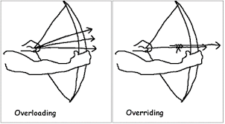
Overloading vs Overriding

Slide 95
Overloading vs Overriding: Java Methods
Method Overloading | Method Overriding
Overloading:Method with same name different signature | Overriding:Method with same name same signature
Known as Compile-time Polymorphism | Known as Run-time Polymorphism
It is performed within class. | It occurs in two classes with IS-A (inheritance) relationship.
Inheritance and method hiding is not involved here. | Here subclass method hides the super class method.

Slide 96
Dynamic Method Dispatch
Dynamic method dispatch is the mechanism by which a call to an overridden method is resolved at run time, rather than compile time.
Dynamic method dispatch is important because this is how Java implements run-time polymorphism.
A
Parent Class
A a = new A(); //object of parent class
B b = new B(); //object of child class
A a = new B();
//Up casting(Dynamic Method Dispatch)
B b= new A();
//Error! Not Allowed
B
Child Class

Slide 97
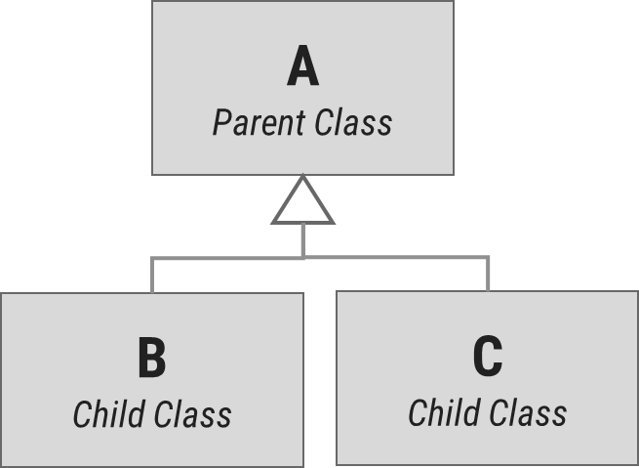
Dynamic Method Dispatch: Example
class A{
void display(){
System.out.println("inside class A");
}
}
class B extends A{
void display(){
System.out.println("inside class B");
}
}
class C extends A{
void display(){
System.out.println("inside class C");
}
}
class DispatchDemo{
public static void main(String[] args) {
A a = new A();
B b = new B();
C c = new C();
A r; //obtain a reference of type A
r=a;
r.display();
r=b;
r.display();
r=c;
r.display();
}
}
Output
inside class A
inside class B
inside class C
Dynamic binding occurs during run-time known as Run-time Polymorphism.

Slide 98
Dynamic Method Dispatch: Example
class Game {
public void type() {
System.out.println("Indoor & outdoor");
}
}
class Cricket extends Game {
public void type() {
System.out.println("outdoor game");
}
}
class Badminton extends Game {
public void type() {
System.out.println("indoor game");
}
}
class Tennis extends Game {
public void type() {
System.out.println("Mix game");
}
}
public class MyProg {
public static void main(String[] args) {
Game g = new Game();
Cricket c = new Cricket();
Badminton b = new Badminton();
Tennis t = new Tennis();
Scanner s = new Scanner(System.in);
System.out.print("Please Enter name of the game = ");
String op = s.nextLine();
if (op.equals("cricket")) {
g = c;
} else if (op.equals("badminton")) {
g = b;
} else if (op.equals("tennis")) {
g = t;
}
g.type();
}
}

Slide 99
“final” keyword
The final keyword is used for restriction.
final keyword can be used in many context
Final can be:
Variable
If you make any variable as final, you cannot change the value of final variable(It will be constant).
Method
If you make any method as final, you cannot override it.
Class
If you make any class as final, you cannot extend it.

Slide 100
1) “final” as a variable
Can not change the value of final variable.
public class FinalDemo {
final int speedlimit=90;//final variable
void run(){
speedlimit=400;
}
public static void main(String args[]){
FinalDemo obj=new FinalDemo();
obj.run();
}
}
final

Slide 101
2) “final” as a method
If you make any method as final, you cannot override it.
class BikeClass{
final void run(){
System.out.println("Running Bike");
}
}
class Pulsar extends BikeClass{
void run(){
System.out.println("Running Pulsar");
}
public static void main(String args[]){
Pulsar p= new Pulsar();
p.run();
}
}
final

Slide 102
3) “final” as a Class
If you make any class as final, you cannot extend it.
final
final class BikeClass{
void run(){
System.out.println("Running Bike");
}
}
class Pulsar extends BikeClass
{
void run(){
System.out.println("Running Pulsar");
}
public static void main(String args[]){
Pulsar p= new Pulsar();
p.run();
}
}

Slide 103
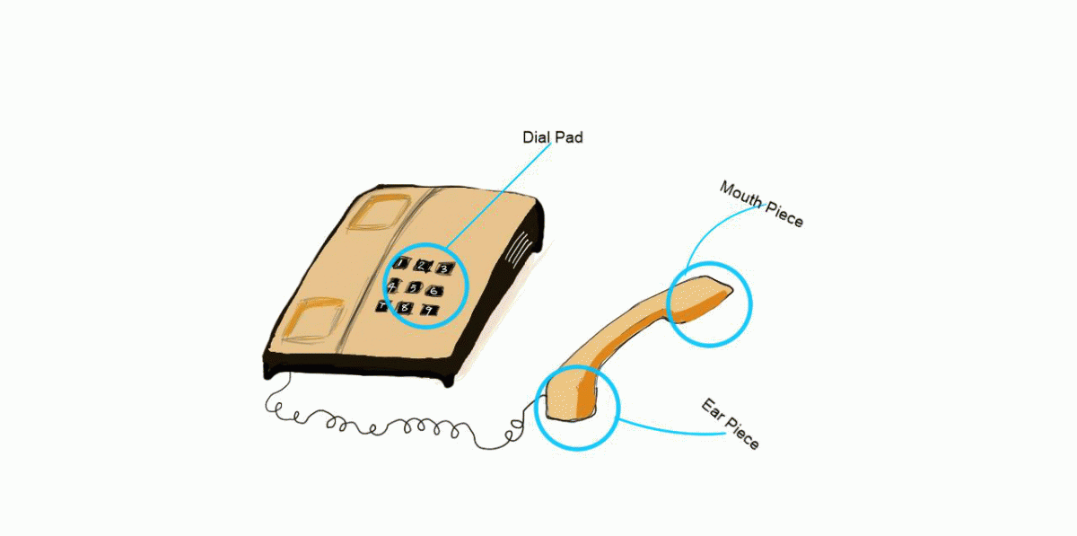
Encapsulation

Slide 104

Encapsulation
Program
Encapsulation
Class
{
Data Members(e.g. int a=10)
+
Methods(e.g. add() )
}
Variables/Data Members
Class
The action of enclosing something in.
In OOP, encapsulation refers to the bundling of data with the methods.
Methods()

Slide 105
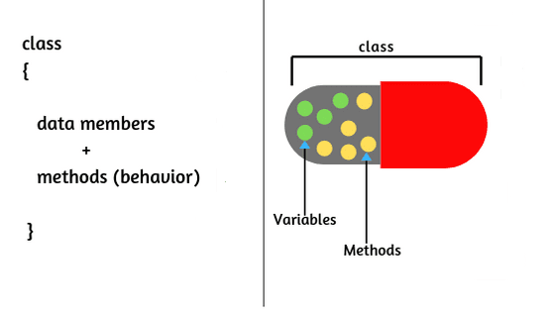
Encapsulation
The wrapping up of data and functions into a single unit is known as encapsulation
The insulation of the data from direct access by the program is called data hiding or information hiding.
It is the process of enclosing one or more details from outside world through access right.
Advantages
Protects an object from unwanted access
It reduces implementation errors.
Simplifies the maintenance of the application and makes the application easy to understand.
Protection of data from accidental corruption.

Slide 106
Abstraction

Slide 107


Abstraction
Data abstraction is also termed as information hiding.
Abstraction is the concept of object-oriented programming that “represents” only essential attributes and “hides” unnecessary information.
Abstraction is all about representing the simplified view and avoid complexity of the system.
It only shows the data which is relevant to the user.
In object-oriented programming, it can be implemented using Abstract Class.
Advantage:
It reduces programming complexity.
Example:
A car is viewed as a car rather than its
numerous individual components.

Slide 108
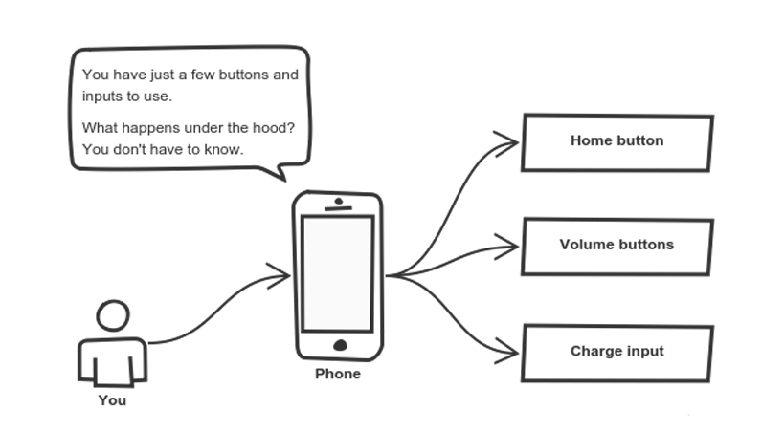
Abstraction

Slide 109
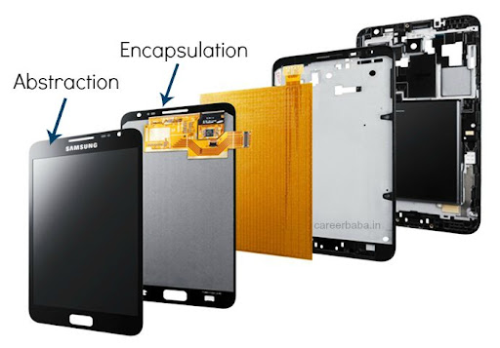
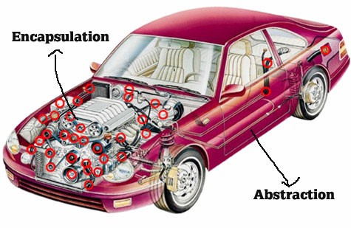
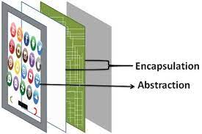
Abstraction vs. Encapsulation
Abstraction | Encapsulation
It means act of removing/ withdrawing something unnecessary. | It is act of binding code and data together and keep the data secure from outside interference.
Applied at Designing stage. | Applied at Implementation stage.
E.g. Interface and Abstract Class | E.g. Access Modifier (public, protected, private)
Purpose: Reduce code complexity | Purpose: Data protection

Slide 110
Implementing Abstraction
Part of Unit-6

Slide 111
Abstract class

Slide 112

Abstract class
Abstraction is a process of hiding the implementation details from the user, only the functionality will be provided to the user.
In other words, the user will have the information on what the object does instead of how the object will do it.
Abstraction is achieved using Abstract classes and interfaces.
A class which contains the abstract keyword in its declaration is known as abstract class.
Abstract classes may or may not contain abstract methods, i.e., methods without body ( public void get(); )
But, if a class has at least one abstract method, then the class must be declared abstract.
If a class is declared abstract, it cannot be instantiated.
To use an abstract class, we have to inherit it to another class and provide implementations of the abstract methods in it.

Slide 113
Abstract class (Example)
abstract class Car {
public abstract double getAverage();
}
class Swift extends Car{
public double getAverage(){
return 22.5;
}
}
class Baleno extends Car{
public double getAverage(){
return 23.2;
}
}
public class MyAbstractDemo{
public static void main(String ar[]){
Swift s = new Swift();
Baleno b = new Baleno();
System.out.println(s.getAverage());
System.out.println(b.getAverage());
}
}
Output
22.5
23.2

Slide 114
Why Abstract Class?
Sometimes, we need to define a superclass that declares the structure of a given abstraction without providing a complete implementation.
The superclass will only define a generalized form, that will be shared by all the subclasses.
The subclasses will fill the details of every method.
When a superclass is unable to create a meaningful implementation for a method.

Slide 115
Points to remember for Abstract Class
To declare a class abstract, you simply use the abstract keyword in front of the class keyword at the beginning of the class declaration.
There can be no objects of an abstract class. That is, an abstract class cannot be directly instantiated with the new operator. Such objects would be useless, because an abstract class is not fully defined.
Cannot declare abstract constructors, or abstract static methods.
Any subclass of an abstract class must either implement all of the abstract methods in the superclass, or be itself declared abstract.

Slide 116

Interface

Slide 117
Interface
An interface is similar to an abstract class with the following exceptions
All methods defined in an interface are abstract.
Interfaces doesn’t contain any logical implementation
Interfaces cannot contain instance variables. However, they can contain public static final variables (ie. constant class variables)
Interfaces are declared using the "interface" keyword
Interfaces are more abstract than abstract classes
Interfaces are implemented by classes using the "implements" keyword
Interfaces are syntactically similar to classes, but they lack instance variables, and their methods are declared without any body.

Slide 118
Interface:Syntax
public or not used(default)
access interface name
{
return-type method-name1(parameter-list);
return-type method-name2(parameter-list);
type final-varname1 = value;
type final-varname2 = value;
// ...
return-type method-nameN(parameter-list);
type final-varnameN = value;
}
Methods are without body(no implementation) and all methods are implicitly abstract.
implicitly final and static, cannot be changed by the implementing class, must
be initialized with a constant value.

Slide 119
Implementing Interfaces
Once an interface has been defined, one or more classes can implement that interface.
To implement an interface, include the implements clause in a class definition, and then create the methods defined by that interface.
access interface name
{
return-type method-name1(parameter-list);
type final-varname1 = value;
}
access class classname
[extends superclass]
[implements interface [,interface...]] {
// class-body
}

Slide 120
Interface (Example)
interface VehicleInterface {
int a = 10;
public void turnLeft();
public void turnRight();
public void accelerate();
public void slowDown();
}
class CarClass implements VehicleInterface
{
public void turnLeft() {
System.out.println("Left");
}
public void turnRight() {
System.out.println("Right");
}
public void accelerate() {
System.out.println("Speed");
}
public void slowDown() {
System.out.println(“Brake");
}
}
Here access specifier of method must be public
public class DemoInterface{
public static void main(String[] a)
{
CarClass c = new CarClass();
c.turnLeft();
}
}
Variable in interface are by default
public, static, final
We have to provide implementation to all the methods of the interface
Output
Left

Slide 121
Interface (Example)
interface VehicleInterface {
int a = 10;
public void turnLeft();
public void turnRight();
public void accelerate();
public void slowDown();
}
class CarClass implements VehicleInterface
{
public void turnLeft() {
System.out.println("Left");
}
public void turnRight() {
System.out.println("Right");
}
public void accelerate() {
System.out.println("Speed");
}
public void slowDown() {
System.out.println(“Brake");
}
}
public class DemoInterface{
public static void main(String[] a)
{
c = new CarClass();
c.turnLeft();
}
}
VehicleInterface
CarClass
variable c is declared to be of the interface type VehicleInterface, yet it was
assigned an instance of CarClass.
Output
Left

Slide 122
Interface: Partial Implementations
If a class includes an interface but does not fully implement the methods defined by that interface, then that class must be declared as abstract.
interface VehicleInterface {
int a = 10;
public void turnLeft();
public void turnRight();
public void accelerate();
public void slowDown();
}
abstract
class CarClass implements VehicleInterface
{
public void turnLeft() {
System.out.println("Left");
}
public void turnRight() {
System.out.println("Right");
}
}
public class DemoInterface{
public static void main(String[] a)
{
CarClass c = new CarClass();
c.turnLeft();
}
}
Either class need to implement all the methods of Interface or declare that class as abstract if partial implementation is required.
public void accelerate() {
System.out.println("Speed");
}
public void slowDown() {
System.out.println(“Brake");
}

Slide 123
Interface:Example
class CreateStack implements StackIntf{
int mystack[];
int tos;
CreateStack(int size){
mystack= new int[size];
tos=-1;
}
public void push(int p){
if(tos==mystack.length-1){
System.out.println("StackOverflow");
}
else{
mystack[++tos]=p;
}
}
public int pop(){
if(tos<0){
System.out.println("StackUnderflow");
return 0;
}
else return mystack[tos--];
}
}
interface StackIntf{
public void
push(int p);
public int pop();
}
StackDemo.java

Slide 124
Interface:Example StackDemo.java
class StackDemo{
public static void main(String[] args) {
CreateStack cs1= new CreateStack(5);
CreateStack cs2= new CreateStack(8);
for(int i=0;i<5;i++)
cs1.push(i);
for(int i=0;i<8;i++)
cs2.push(i);
System.out.println("MyStack1=");
for(int i=0;i<5;i++)
System.out.println(cs1.pop());
System.out.println("MyStack2=");
for(int i=0;i<8;i++)
System.out.println(cs2.pop());
}
}

Slide 125
Interfaces Can Be Extended
One interface can inherit another by use of the keyword extends.
The syntax is the same as for inheriting classes.
When a class implements an interface that inherits another interface, it must provide implementations for all methods defined within the interface inheritance chain.

Slide 126
InterfaceHierarchy.java
class MyClass1 implements B{
public void method1(){
System.out.println("inside MyClass1:method1()");}
public void method2(){
System.out.println("inside MyClass1:method2()");
}
public void method3(){
System.out.println("inside MyClass1:method3()");
}
}
interface A{
void method1();
void method2();
}
interface B extends A{
void method3();
}
interface C extends A{
void method4();
}
class InterfaceHierarchy{
public static void main
(String[] args) {
MyClass1 c1=new MyClass1();
MyClass2 c2=new MyClass2();
c1.method1();
c1.method2();
c1.method3();
c2.method1();
c2.method2();
c2.method4();
}
}
class MyClass2 implements C{
public void method1(){
System.out.println("inside MyClass2:method1()");}
public void method2(){
System.out.println("inside MyClass2:method2()");
}
public void method4(){
System.out.println("inside MyClass2:method4()");
}
}

Slide 127
Interface: Points to Remember
Any number of classes can implement an interface.
One class can implement any number of interfaces.
To implement an interface, a class must create the complete set of methods defined by the interface. However, each class is free to determine the details of its own implementation.

Slide 128
Abstract class vs. Interface
Abstract class | Interface
Abstract class doesn't support multiple inheritance. | Interface supports multiple inheritance.
Abstract class can have abstract and non-abstract methods. | Interface can have only abstract methods.
Abstract class can have final, non-final, static and non-static variables. | Interface has only static and final variables.
An abstract class can extend another Java class and implement multiple Java interfaces. | An interface can extend another Java interface only.
A Java abstract class can have class members like private, protected, etc. | Members of a Java interface are public by default.

Slide 129
Abstraction vs. Encapsulation

Slide 130
Advantages of Object-Oriented Programming

Slide 131
Advantages of Object-Oriented Programming
Security
Upgrade-able
Flexibility
High-quality Software
Reusability
Easy Partition
Maintenance
Portability

Slide 132
instanceof operator
instanceof Operator
Syntax:
( Object reference variable ) instanceof (class/interface type)
Example:
boolean result = name instanceof String;

Slide 133
Wrapper classes
A Wrapper class is a class whose object wraps or contains a primitive datatypes.
When we create an object to a wrapper class, it contains a field and in this field, we can store a primitive datatypes.
In other words, we can wrap a primitive value into a wrapper class object.
Use of wrapper class :
They convert primitive datatypes into objects.
The classes in java.util package handles only objects and hence wrapper classes help in this case also.
Data structures in the Collection framework, such as ArrayList and Vector, store only objects (reference types) and not primitive types.
An object is needed to support synchronization in multithreading.

Slide 134
Wrapper classes (Cont.)
Primitive datatype | Wrapper class | Example
byte | Byte | Byte b = new Byte((byte) 10);
short | Short | Short s = new Short((short) 10);
int | Integer | Integer i = new Integer(10);
long | Long | Long l = new Long(10);
float | Float | Float f = new Float(10.0);
double | Double | Double d = new Double(10.2);
char | Character | Character c = new Character('a');
boolean | Boolean | Boolean b = new Boolean(true);
Common Fields (Except Boolean):
MIN_VALUE : will return the minimum value it can store.
MAX_VALUE : will return the maximum value it can store.

Slide 135
Parsing the String
Using wrapper class we can parse string to any primitive datatype (Except char).
byte b1 = Byte.parseByte("10");
short s = Short.parseShort("10");
int i = Integer.parseInt("10");
long l = Long.parseLong("10");
float f = Float.parseFloat("10.5");
double d = Double.parseDouble("10.5");
boolean b2 = Boolean.parseBoolean("true");
char c = Character.parseCharacter('a');
Note : for Integer class we have parseInt not parseInteger

Slide 136
BigInteger and BigDecimal
The BigInteger class found in java.math package is used for mathematical operation which involves very big integer calculations that are outside the limit of all available primitive data types.
For example factorial of 100 contains 158 digits in it so we can’t store it in any primitive data type available.
There is no theoretical limit on the upper bound of the range because memory is allocated dynamically
The BigDecimal class found in java.math package provides operation for arithmetic, comparison, hashing, rounding, manipulation and format conversion.
This method can handle very small and very big floating point numbers with great precision.
import java.math.BigInteger;
public class DemoBigNumbers {
public static void main(String[] args) {
BigInteger bi = new BigInteger("1234567891234567891234567890");
System.out.println(bi); // will return 1234567891234567891234567890
}
}
BigDecimal bd = new BigDecimal("111111.000000000000000000025");
System.out.println(bd); //111111.000000000000000000025

Slide 137
String Class
An object of the String class represents a string of characters.
The String class belongs to the java.lang package, which does not require an import statement.
Like other classes, String has constructors and methods.
String class has two operators, + and += (used for concatenation).
Empty String :
An empty String has no characters. It’s length is 0.
Not the same as an uninitialized String.
String word1 = "";
String word2 = new String();
Empty strings
String word1;
This is null

Slide 138
String Initialization
Copy constructor creates a copy of an existing String.
Copy Constructor: Each variable points to a different copy of the String.
String word = new String("Java");
String word2 = new String(word);
word
"Java"
word2
"Java"
Assignment: Both variables point to the same String.
String word = "Java";
String word2 = word;
word
"Java"
word2

Slide 139
String Immutability
Advantage
Disadvantage
Convenient — Immutable objects are convenient because several references can point to the same object safely.
Less efficient — you need to create a new string and throw away the old one even for small changes.
String name="DIET - Rajkot";
foo(name);
//Some operations on String name
name.substring(7,13);
bar(name);
/* we will be sure that the value of name will be same for foo() as well as bar() as String is immutable its value will be same for both the functions.
*/
String word = "java";
char ch =
Character.toUpperCase(
word.charAt (0));
word = ch + word.substring (1);
word
"java"
"Java"

Slide 140
String Methods — length, charAt
int length();
Returns the number of characters in the string
Returns:
"Problem".length();
7
int charAt(i);
Returns the char at position i.
Character positions in strings starts from 0 – just like arrays.
Returns:
"Window".charAt (2);
'n'

Slide 141
String Methods — substring
We can obtain a portion of a string by use of substring(), It has two forms
String subs = word.substring (i, k);
returns the substring of chars in positions from i to k-1
String subs = word.substring (i);
returns the substring from the i-th char to the end
television
i k
immutable
i
Returns:
"television".substring(2,5);
"immutable".substring(2);
"rajkot".substring(9);
“lev"
“mutable"
"" (empty string)

Slide 142
String Methods — Concatenation
public class ConcatenationExample{
public static void main(String[] args) {
String word1 = "re";
String word2 = "think";
String word3 = "ing";
int num = 2;
String result = word1 + word2;
// concatenates word1 and word2 "rethink"
result = word1.concat(word2);
// the same as word1 + word2 "rethink"
result += word3;
// concatenates word3 to result "rethinking"
result += num;
// converts num to String & joins it to result "rethinking2"
}
}

Slide 143
String Methods — Find (indexOf)
String name = " ";
name.indexOf ('P');
name.indexOf ('e');
name.indexOf ("Minister");
name.indexOf ('e', 8);
name.indexOf (“xyz");
name.lastIndexOf ('e');
P | r | i | m | e |  | M | i | n | i | s | t | e | r
0 | 1 | 2 | 3 | 4 | 5 | 6 | 7 | 8 | 9 | 10 | 11 | 12 | 13
0
4
6
12
(starts searching at position 8)
-1
(not found)
18

Slide 144
String Methods — Equality
boolean b = word1.equals(word2);
returns true if the string word1 is equal to word2
boolean b = word1.equalsIgnoreCase(word2);
returns true if the string word1 matches word2, ignoring the case of the string.
b = "Raiders".equals("Raiders"); // will return true
b = "Raiders".equals("raiders"); // will return false
b = "Raiders".equalsIgnoreCase("raiders"); // will return true

Slide 145
String Methods — Comparisons
int diff = word1.compareTo(word2);
returns the “difference” word1 - word2
int diff = word1.compareToIgnoreCase(word2);
returns the “difference” word1 - word2, ignoring the case of the strings
Usually programmers don’t care what the numerical “difference” of word1 - word2 is, what matters is if
the difference is negative (word1 less than word2),
zero (word1 and word2 are equal)
or positive (word1 grater than word2).
Often used in conditional statements.
if(word1.compareTo(word2) > 0){
//word1 grater than word2…
}

Slide 146
Comparison Examples
//negative differences
diff = "apple".compareTo("berry"); // a less than b
diff = "Zebra".compareTo("apple"); // Z less than a
diff = "dig".compareTo("dug"); // i less than u
diff = "dig".compareTo("digs"); // dig is shorter
//zero differences
diff = "apple".compareTo("apple"); // equal
diff = "dig".compareToIgnoreCase("DIG"); // equal
//positive differences
diff = "berry".compareTo("apple"); // b grater than a
diff = "apple".compareTo("Apple"); // a grater than A
diff = "BIT".compareTo("BIG"); // T grater than G
diff = "application".compareTo("app"); // application is longer

Slide 147
String Methods — trim & replace
trim() method
replace() method
String word2 = word1.trim();
returns a new string formed from word1 by removing white space at both ends,
it does not affect whites space in the middle.
String word2 = word1.replace(oldCh, newCh);
returns a new string formed from word1 by replacing all occurrences of oldCh with newCh
String word1 = " Hello From Darshan ";
String word2 = word1.trim();
// word2 is "Hello From Darshan"
// no spaces on either end
String word1 = "late";
String word2 = word1.replace('l', 'h');
System.out.println(word2);
//Output : "hate"
String str1 = "Hello World";
String str2 = str1.replace("World","Everyone");
System.out.println(str2);
// Output : "Hello Everyone"

Slide 148
String Methods — Changing Case
String word2 = word1.toUpperCase();
returns a new string formed from word1 by converting its characters to upper case
String word3 = word1.toLowerCase();
returns a new string formed from word1 by converting its characters to lower case
String word1 = "HeLLo";
String word2 = word1.toUpperCase(); // "HELLO"
String word3 = word1.toLowerCase(); // "hello"

Slide 149
StringBuffer
The java.lang.StringBuffer class is a thread-safe, mutable sequence of characters.
Following are the important points about StringBuffer:
A string buffer is like a String, but can be modified (mutable).
It contains some particular sequence of characters, but the length and content of the sequence can be changed through certain method calls.
They are safe for use by multiple threads.
StringBuffer Constructors
S.N | Constructor & Description
1 | StringBuffer() This constructs a string buffer with no characters in it and an initial capacity of 16 characters.
2 | StringBuffer(CharSequence seq) This constructs a string buffer that contains the same characters as the specified CharSequence.
3 | StringBuffer(int capacity) This constructs a string buffer with no characters in it and the specified initial capacity.
4 | StringBuffer(String str) This constructs a string buffer initialized to the contents of the specified string.

Slide 150
StringBuffer Methods
Remember : “StringBuffer” is mutable
As StringBuffer class is mutable we need not to replace the reference with a new reference as we have to do it with String class.
Method | description
append(String s) | is used to append the specified string with this string.
insert(int offset, String s) | is used to insert the specified string with this string at the specified position.
replace(int startIndex, int endIndex, String str) | is used to replace the string from specified startIndex and endIndex.
delete(int startIndex, int endIndex) | is used to delete the string from specified startIndex and endIndex.
reverse() | is used to reverse the string.
StringBuffer str1 = new StringBuffer("Hello Everyone");
str1.reverse();
// as it is mutable can not write str1 = str1.reverse();
// it will change to value of the string itself
System.out.println(str1);
// Output will be “enoyrevE olleH”

Slide 151
String Builder
Java StringBuilder class is used to create mutable string.
The Java StringBuilder class is same as StringBuffer class except that it is non-synchronized.
It is available since JDK 1.5.
It has similar methods as StringBuffer like append, insert, reverse etc…

Slide 152
ArrayList
The java.util.ArrayList class provides resizable-array and implements the List interface.
Following are the important points about ArrayList:
It implements all optional list operations and it also permits all elements, including null.
It provides methods to manipulate the size of the array that is used internally to store the list.
ArrayList (constructors) :
S.N. | Constructor & Description
1 | ArrayList() This constructor is used to create an empty list with an initial capacity sufficient to hold 10 elements.
2 | ArrayList(Collection<? extends E> c) This constructor is used to create a list containing the elements of the specified collection.
3 | ArrayList(int initialCapacity) This constructor is used to create an empty list with an initial capacity.

Slide 153
ArrayList (method)
S.N. | Method & Description
1 | void add(int index, E element) This method inserts the specified element at the specified position in this list.
2 | boolean addAll(Collection<? extends E> c) This method appends all of the elements in the specified collection to the end of this list, in the order that they are returned by the specified collection's Iterator
3 | void clear() This method removes all of the elements from this list.
4 | boolean contains(Object o) This method returns true if this list contains the specified element.
5 | E get(int index) This method returns the element at the specified position in this list.
6 | int indexOf(Object o) This method returns the index of the first occurrence of the specified element in this list, or -1 if this list does not contain the element.

Slide 154
ArrayList (method) (cont.)
S.N. | Method & Description
7 | boolean isEmpty() This method returns true if this list contains no elements.
8 | int lastIndexOf(Object o) This method returns the index of the last occurrence of the specified element in this list, or -1 if this list does not contain the element.
9 | boolean remove(Object o) This method removes the first occurrence of the specified element from this list, if it is present.
10 | E set(int index, E element) This method replaces the element at the specified position in this list with the specified element.
11 | int size() This method returns the number of elements in this list.
12 | Object[] toArray() This method returns an array containing all of the elements in this list in proper sequence (from first to last element).

Slide 155
Thank You

